Slide 1
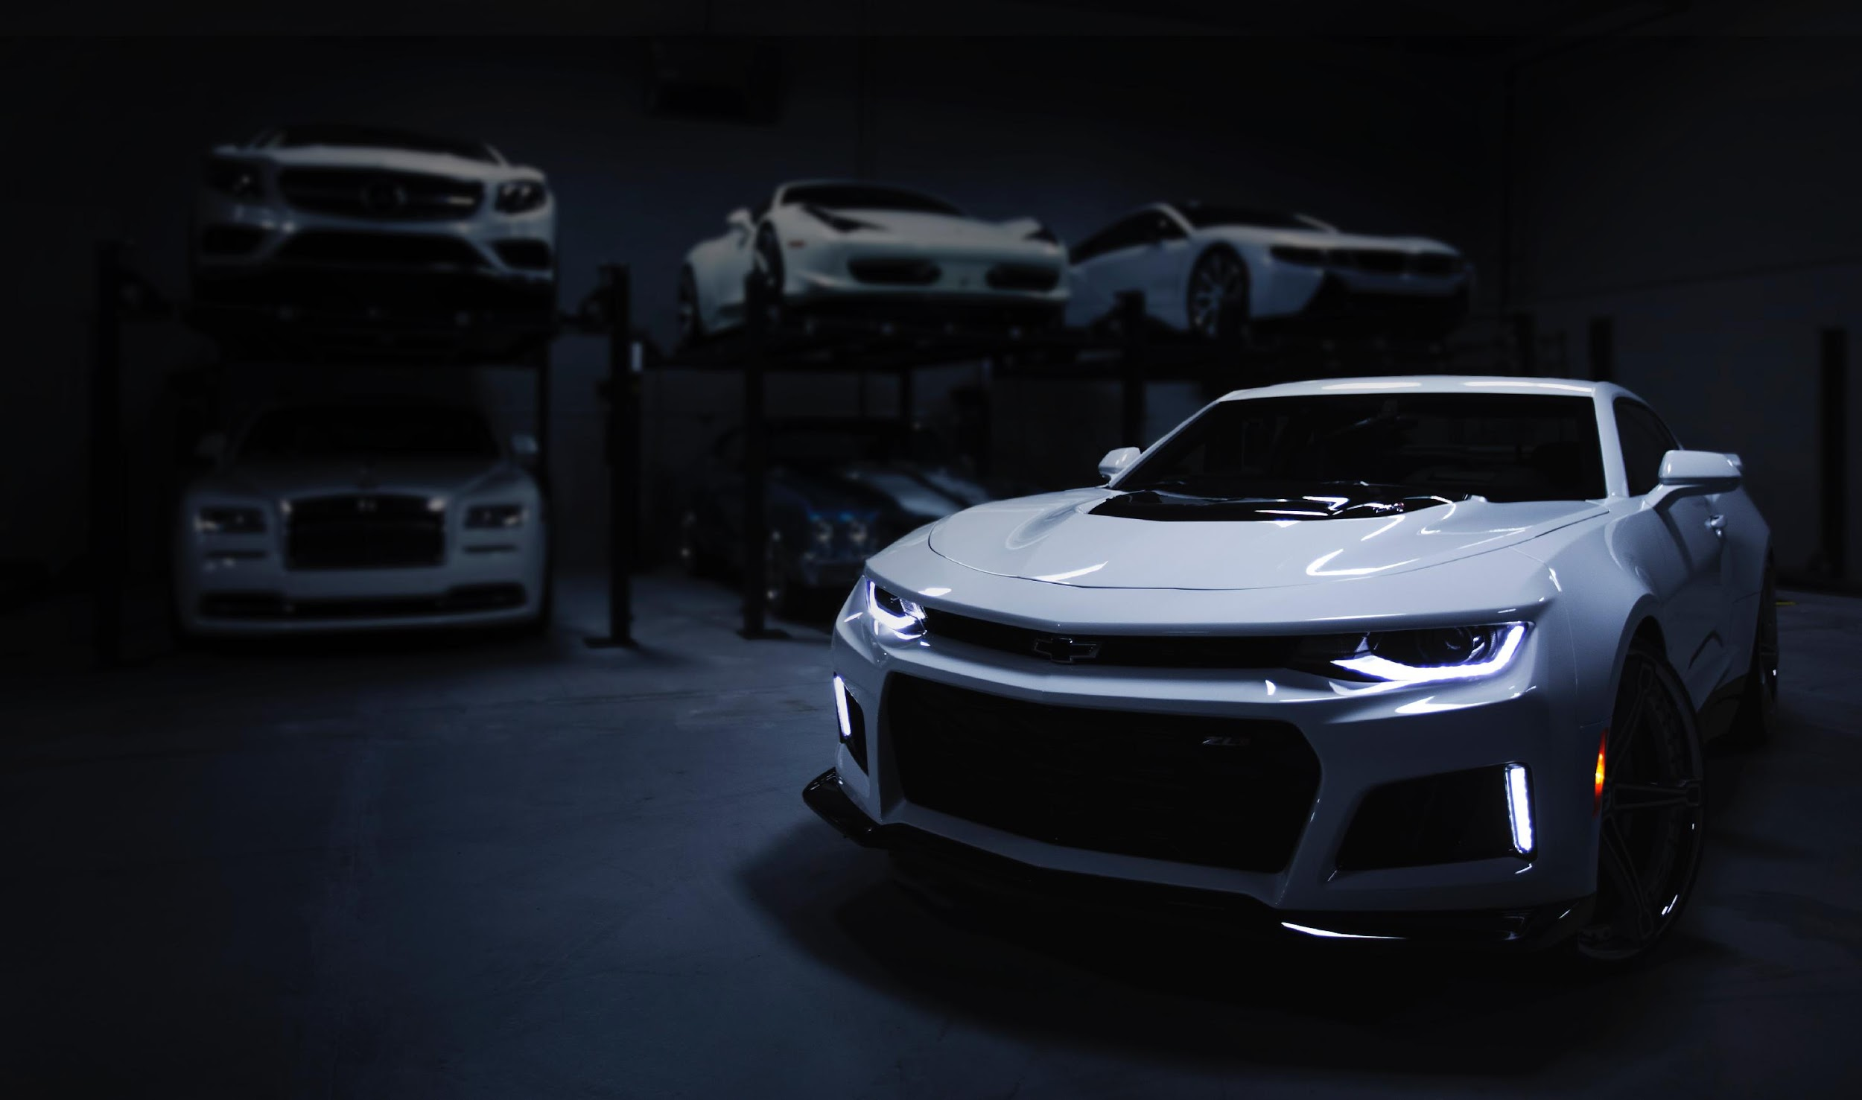
Progress Report 2
Abdillah Fikri
Kintan Pitaloka W
Rizky Muhammad Kahfie
Kelompok 10
10 Oktober 2020
Predicting the Price of Used Cars
Using Machine Learning

Slide 2
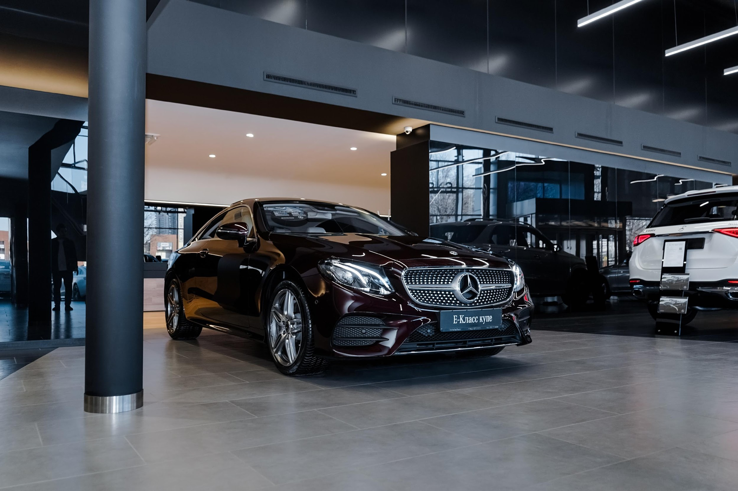
EXPLORATORY DATA ANALYSIS

Slide 3
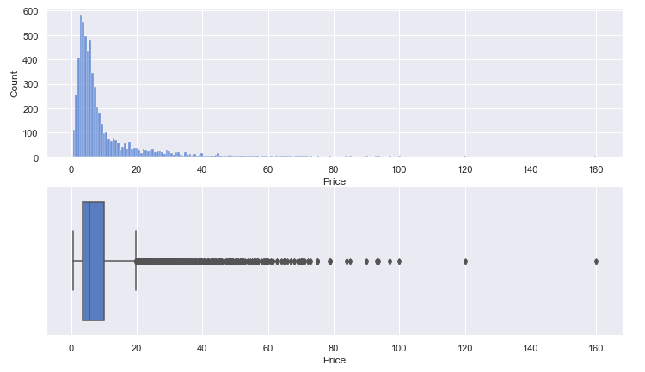
Univariate Analysis
Target variable
The target variable (Price) has a right-skewed distribution with many outliers.
2 cars with the highest price are:
Land rover
Lamborghini Gallardo

Slide 4
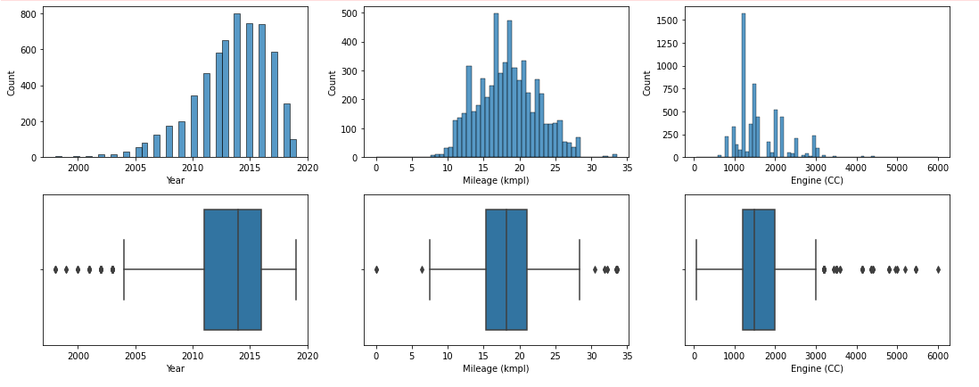
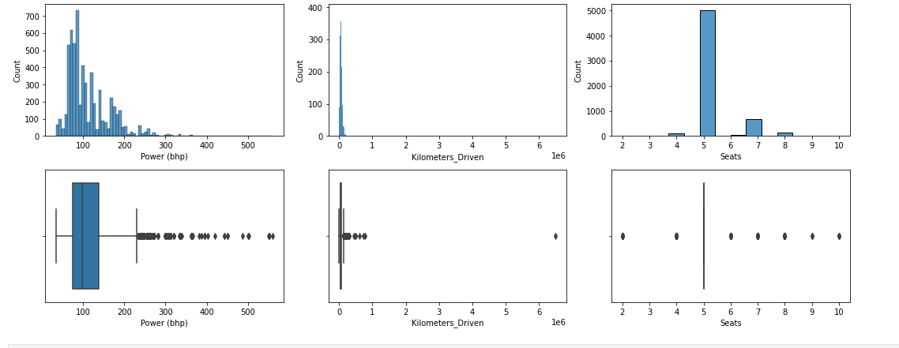
Univariate Analysis
Numerical
Exploring Univariate Analysis :
Median in Year is 2014
Median in Price is 5.64
Median in Mileage is 18.2
Median in Engine is 1493
Median in Power is 97.7
The highest Kilometer Driven 6,500,000 (which is an outlier that need to be removed)
Year, Power, Engine, and Kilometer Driven have skewed distribution.

Slide 5
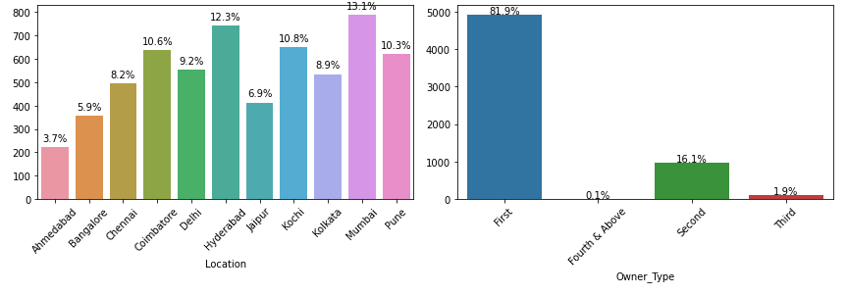
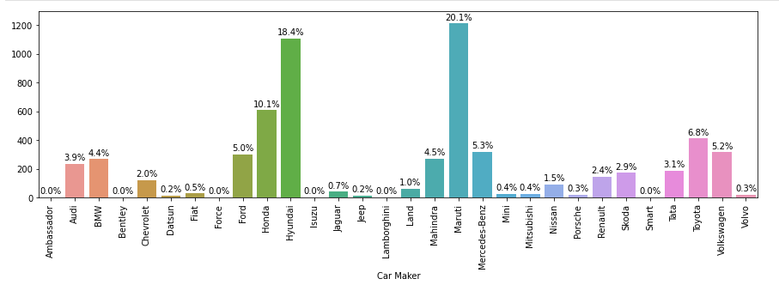
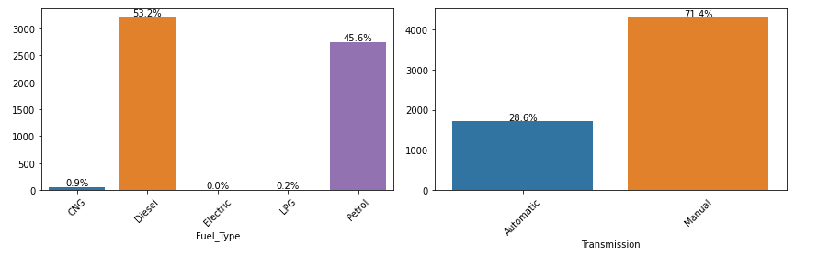
Univariate Analysis
Categorical
Exploring Univariate Analysis :
The most frequent Location is Mumbai
More use Diesel fuel than petrol
The most frequent Transmission is Manual
The top Car Type is Swift.
Maruti seemed to be a favored car company.
It seems many people like cars with 5 seats

Slide 6
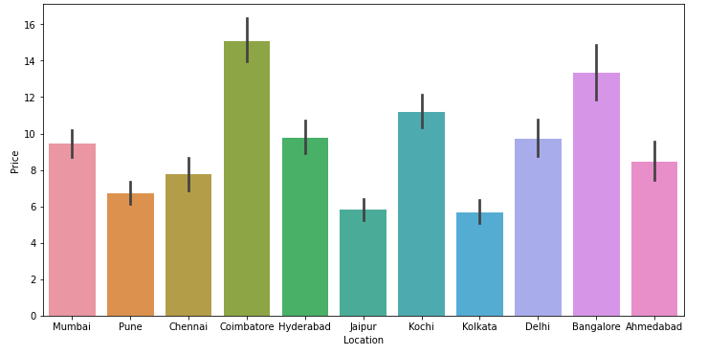
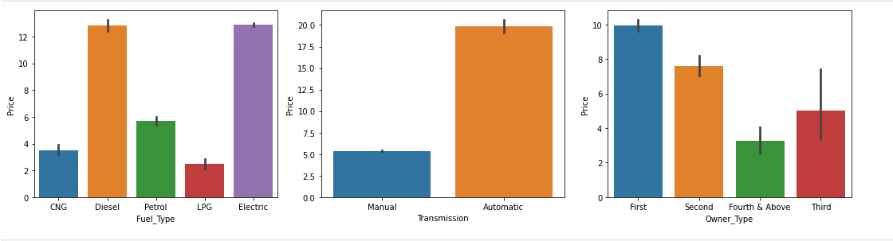
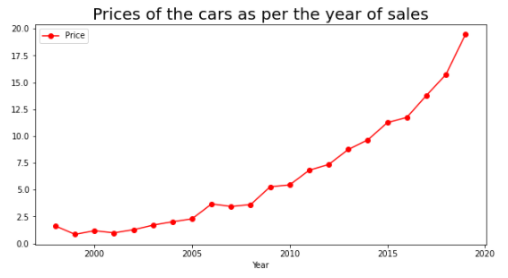
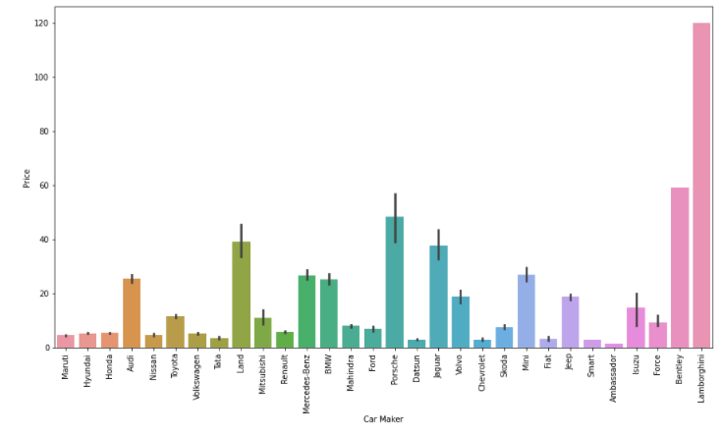
Bivariate Analysis
Exploring Bivariate Analysis :
Coimbatore have highest average price
Lamborghini seem to have a high average price
Diesel and Electric have high average price than petrol
Automatic transmission average price is higher than Manual
First Owner Type have a high average price

Slide 7
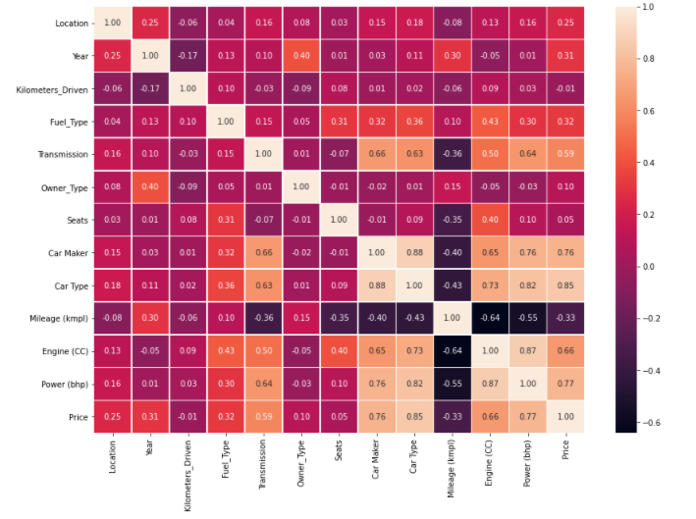
Correlation plot
Have Strong Correlation with Price :
Car Type
Power(bhp)
Car Maker
Engine (CC)
Transmission
Mileage (kmpl)
Fuel_Type
Year
However, there are some independent variables that have strong correlation. We need to do feature selection with those variables or use tree-based algorithm instead.

Slide 8
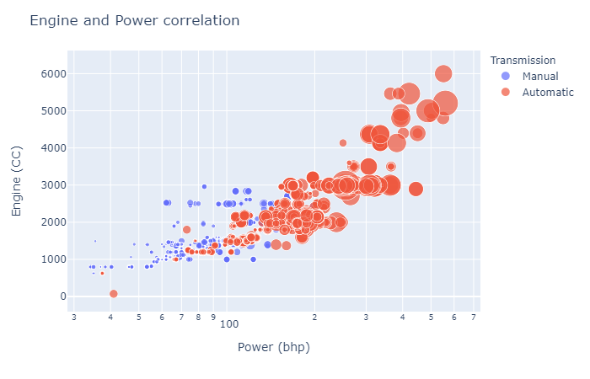
Multivariable comparison
Insight :
Engine and Power has strong positive correlation as describe in scatter plot
Car price will getting expensive inline with Power and Engine.
Car with Automatic transmission has higher price.
Note : Size/besar bubble menunjukkan harga yang semakin tinggi.

Slide 9
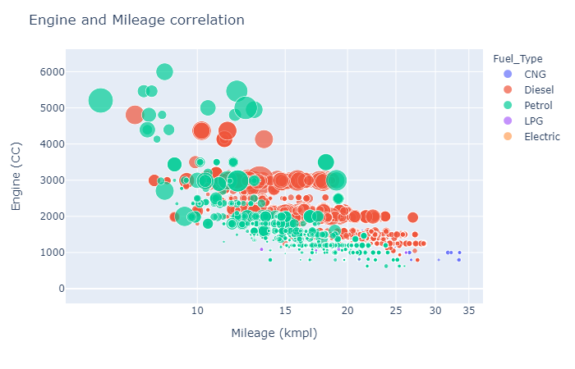
Multivariable comparison
Insight :
Engine and Mileage has negative strong correlation.
Car with higher Mileage tends to has lower price.
Cars with the Petrol type tend to be more wasteful than the others.
Cars with CNG fuel have the cheapest prices and the most fuel efficient.
Note : Size/besar bubble menunjukkan harga yang semakin tinggi.

Slide 10
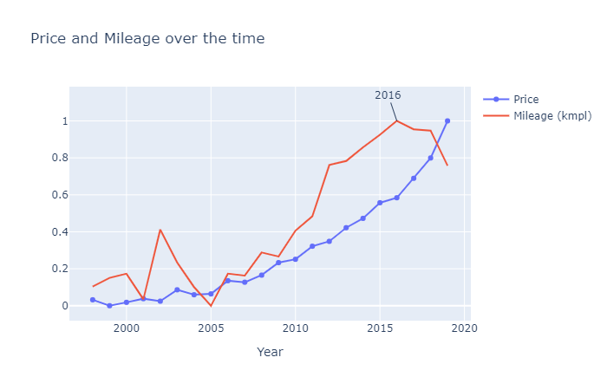
Multivariable comparison
Insight :
The average price of cars in our dataset has an upward trend every year.
Mileage also has a significant upward trend until 2016. However, it then decreased after 2016.

Slide 11
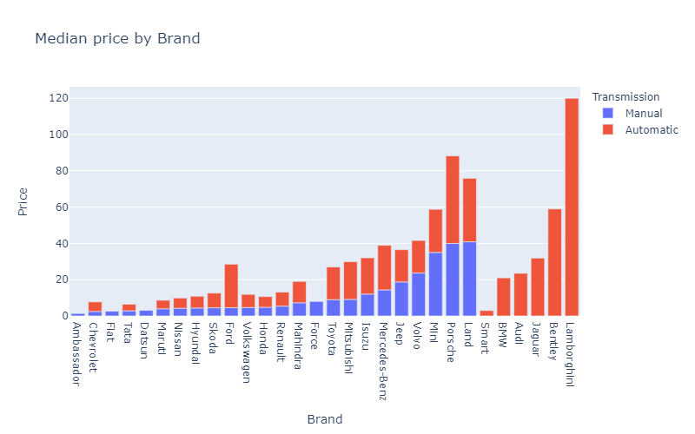
Multivariable comparison
Insight :
Lamborghini has the highest median price.
There are 10 cars in our dataset that do not have variations on transmission (6 only Automatic and 4 only Manual).
Automatic cars have a higher median price compared to Manual cars.

Slide 12
Data Cleansing

Slide 13
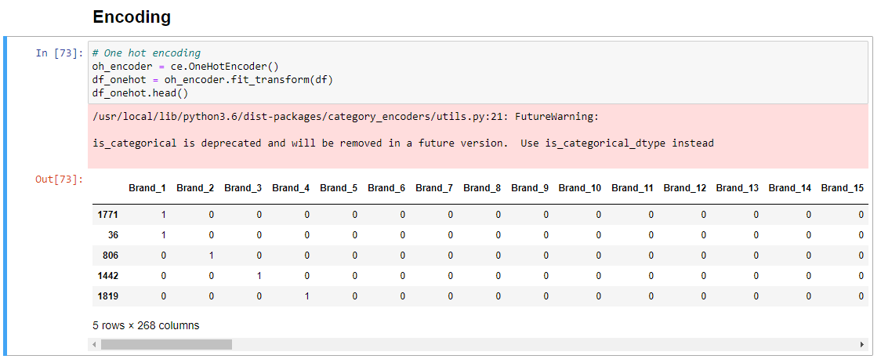
Encoding
Categorical Encoding:
Using one hot encoder to encode categorical variables.

Slide 14
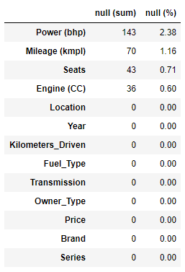
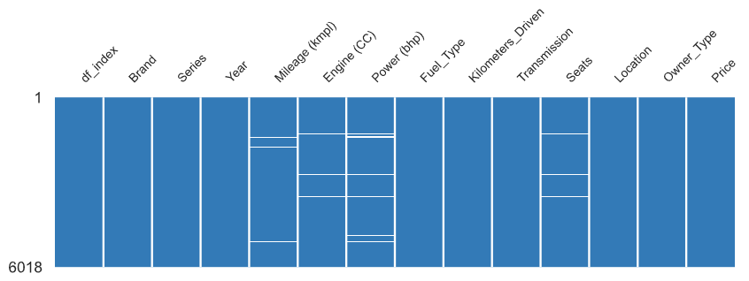
Missing Value Handling (Option 1)
Data Cleansing (solve missing value) :
Because the percentage of missing values in our dataset is quite small (at most 2.38%) and also most of it are missing on the same row, option 1 is to remove these missing values.

Slide 15
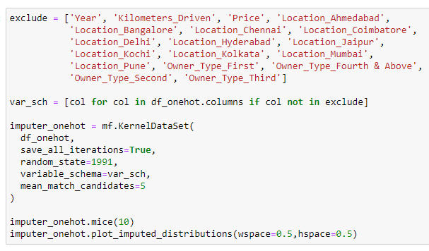
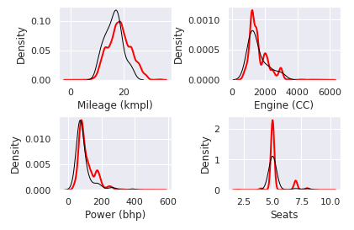

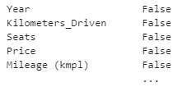
Missing Value Handling (Option 2)
Data Cleansing (solve missing value) :
Option 2 is using miceforest (MICE Algorithm) to impute missing values
Result = df_imputed

Slide 16
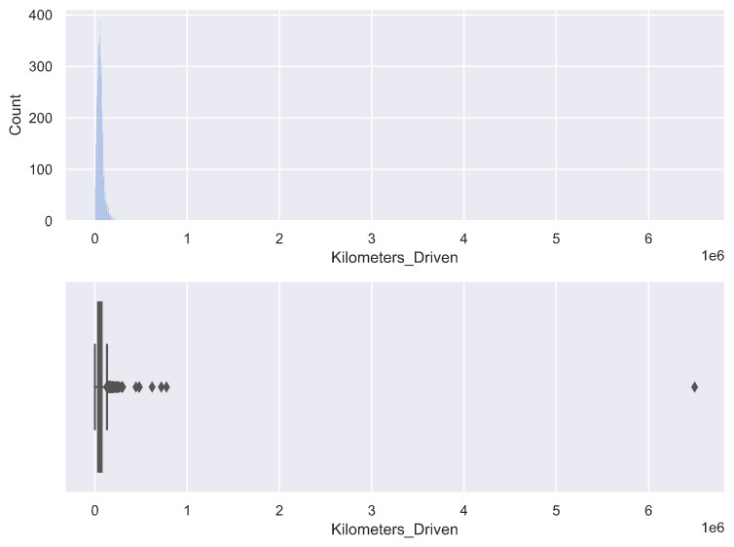
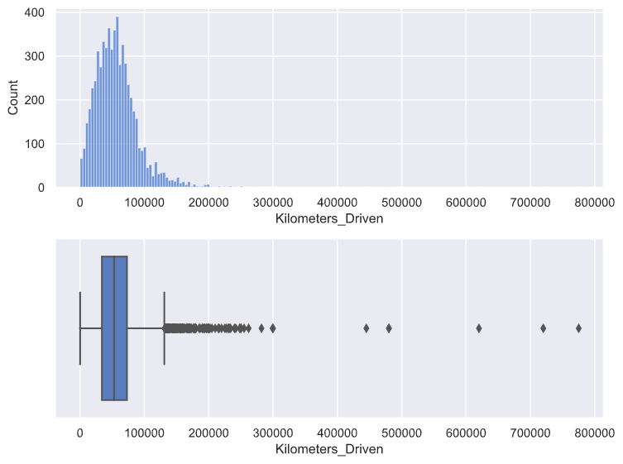
Outlier Handling
Before
After
Data Cleansing (Outlier) :
There are outliers in Kilometers Driven variable with value of 6,500,000.
The outlier is removed.

Slide 17
Next Plan
Modeling :
Do modeling with multiple machine learning to compare the performance.
Do modeling on 2 datasets namely the dataset with dropped missing values and imputed missing values to compare their performance.
Perform additional engineering features (if necessary) by looking at the results of the model, whether it can predict well with the current data.

